Slide 1
Morse Code Encoding & Decoding Application
.
.
.
.
.
-
.
-
-
.
.
.
.
.
-
.
-
-
Developed By: Muhammad Raheel
Participant: Individual
Project Name: Morse Code

Slide 2
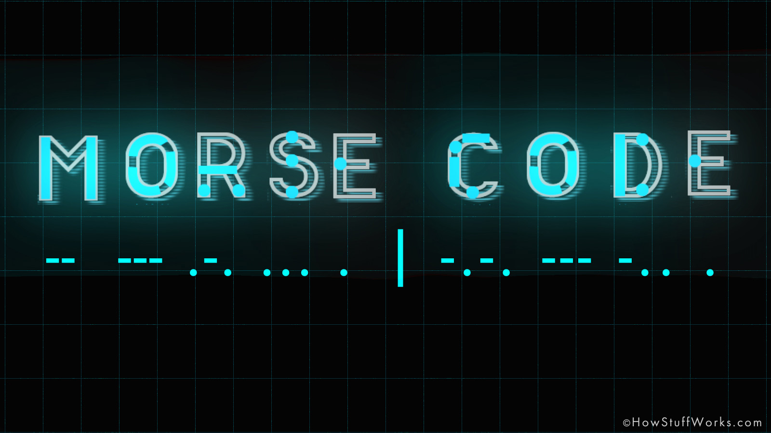

Slide 3


Why We Need Morse Code In This Era?

Slide 4
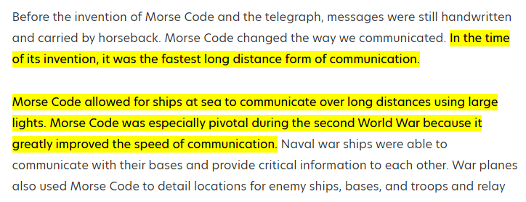
Why We Need Morse Code In This Era?

Slide 5
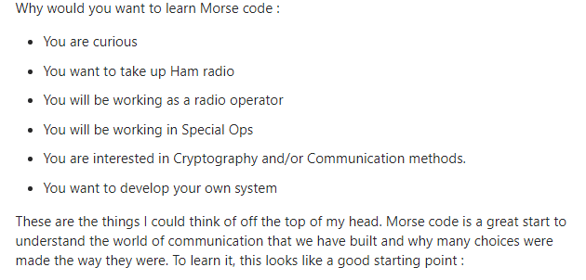
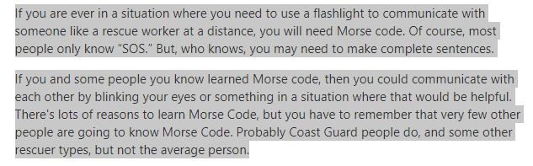
Should We Learn Morse Code In This Era & What Is The Used Of Morse Code?

Slide 6
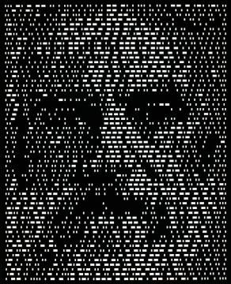
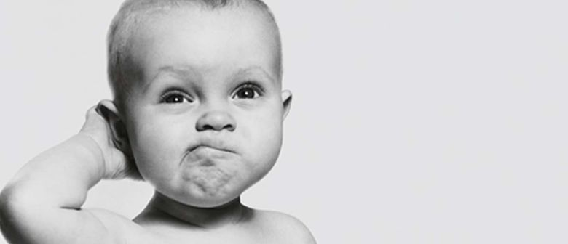

Morse code illusion

Slide 7
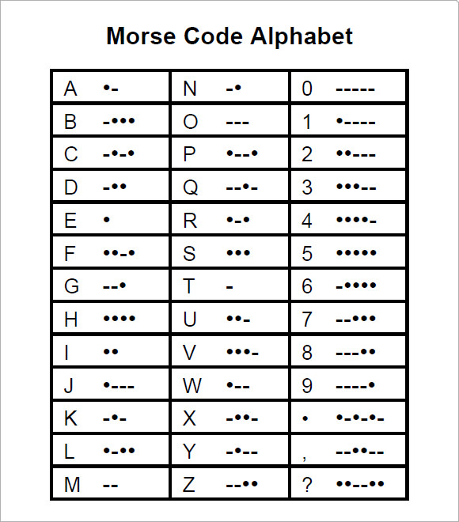

Slide 8
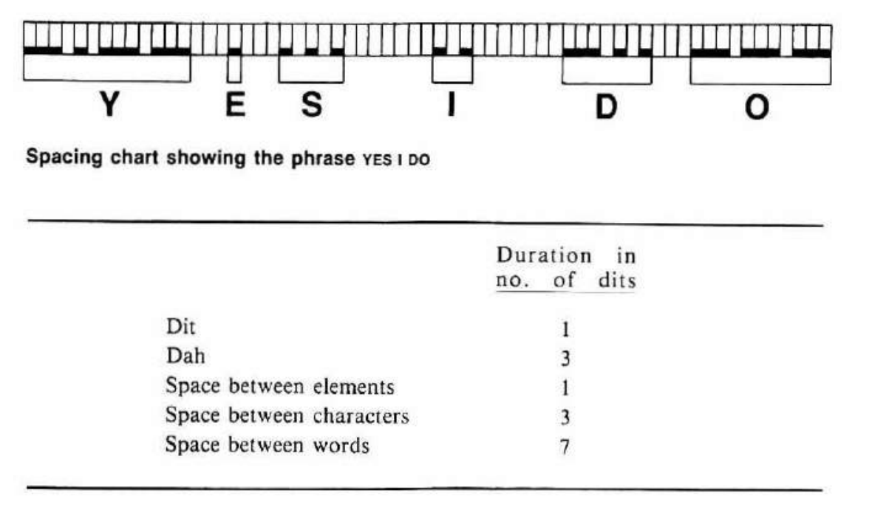

Slide 9
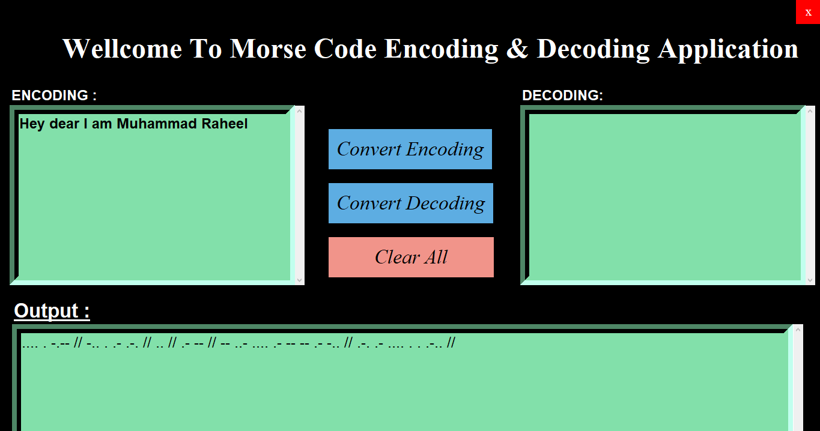

Slide 10
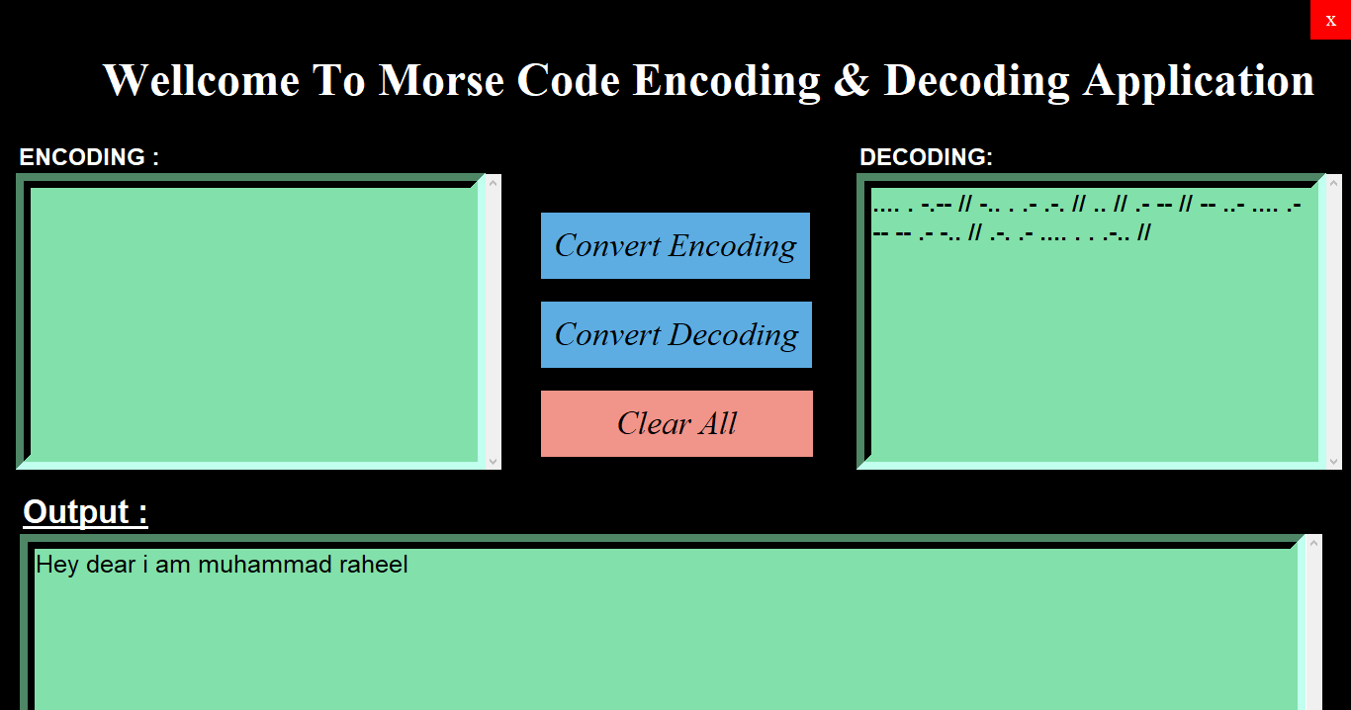

Slide 11
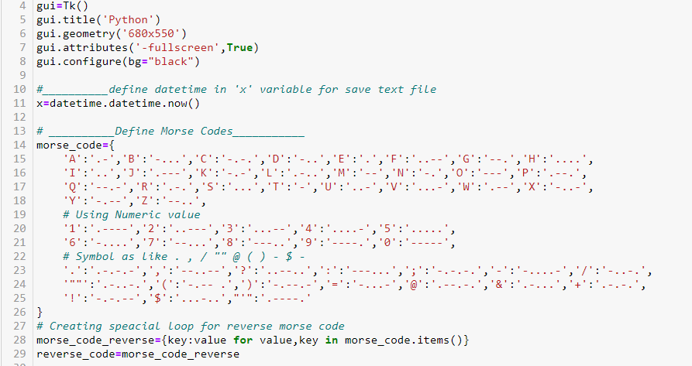

Slide 12
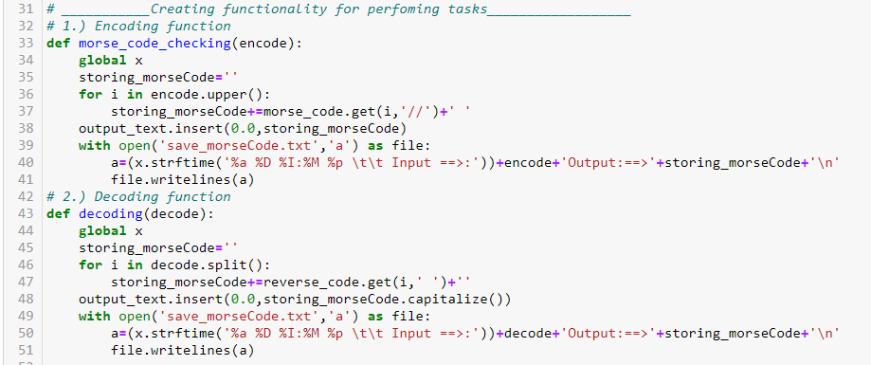

Slide 13


